Slide 1
NATIONAL INSTITUTE OF TECHNOLOGY SILCHAR
Cachar, Assam
A Research Paper Presentation
on
An Architecture for Software Engineering Gamification
by Oscar Pedreira, Félix García, Mario Piattini, Alejandro Cortiñas, Ana Cerdeira-Pena
Software Engineering
CS-304
Presented By:
Subhojit Ghimire
CSE-B, 1912160

Slide 2
CITATION
Pedreira, Oscar, Félix García, Mario Piattini, Alejandro Cortiñas and Ana Cerdeira-Pena. “An architecture for software engineering gamification.” Tsinghua Science & Technology 25 (2020): 776-797.
Research Paper Links:
[ https://www.semanticscholar.org/paper/An-architecture-for-software-engineering-Pedreira-García/0907cd48c5743716bd699e4f5dd3dca5750713db ]
[ https://ieeexplore.ieee.org/ielx7/5971803/9087808/09087817.pdf ]

Slide 3
UNDERSTANDING THE TOPIC
Gamification refers to utilisation of game-like tools and mechanics in regular non-game workplace environment.
Software Engineering Gamification refers to using gamification tools and engines to make a regular software more interactive, engaging and motivating.
Architecture for Software Engineering Gamification deals with the building and implementation of these gamification engines in any regular software.

Slide 4
UNDERSTANDING THE PAPER
“An Architecture for Software Engineering Gamification” is more focused on the approach to implementing game-like tools in all sorts of easy and complex software.
This paper is not aimed at forcing gamification or showing that gamification can improve the result of software engineering companies, but rather focuses on providing the necessary tools to those companies who plan on welcoming the idea of gamification in their newer projects.
The prime agenda of this research paper is to study the compatibility of the necessary tools in the modern software and addresses the software architecture of the gamification engine for gamification in SE environment.

Slide 5
SUMMARISING BACKGROUND
Much research work has considered the application of gamification in SE, the goal being to improve product quality and project results by increasing people’s motivation and engagement.
One of the most significant lines of research in gamification has been the evidence about its usefulness, which was initially evaluated by Hamari et al. by means of a literature review. This study concluded that “gamification does work, but some caveats exist”, as most papers report positive results from gamification (with some empirical evidence), but some underlying confounding factors were also present.
A more general systematic mapping on gamification in software engineering found that the adoption of gamification in SE is going more slowly than in other domains, such as marketing, education, health, or banking

Slide 6
RESEARCH QUESTIONS
Can there be a gamification software that will allow the software organisations to transform work environment of a software into an integrated gamified environment while maintaining the organisation’s current tools?
Can the rewards for actions in any tool accumulate in a centralized gamified environment?
Does the design of behaviours, achievements and gamification rules provided by the framework makes the gamified work environment flexible? Can the change to game mechanics be modified through only the designer’s web interface without the need for touching a line of code?

Slide 7
SEARCH PROCESS, STUDY SELECTION AND ANALYSIS
The search and study selection process for this research process includes defining the major search terms that include the terms gamification, software engineering and architecture, as well as identifying synonyms for these three major terms.
Next steps include linking the search keywords using logical terms AND and OR. Lastly, search process was concluded by selecting and surveying primary sources like IEEE, ACM, SCOPUS, Web of Science and ScienceDirect.
To analyse the data extracted after conducting study selection, authors for this research employed the thematic analysis steps (Extract Data, Code Data, Translate Codes Into Themes, Explore Relations) following the guidelines by Cruzes and Dyba using NVivo 11 as a supporting tool.

Slide 8
APPROACH
An existing gamification approach was used that included the studies following an existing gamification framework that was proposed by someone else.
A psychological approach was adapted as a gamification approach that included the normal work-environment that tailored motivational or inspirational theories to gamify an existing software.
A new gamification approach was proposed, designed and followed that included studies that designed their own structured and step-by-step methodology to gamify an existing software as well as in-production software.

Slide 9
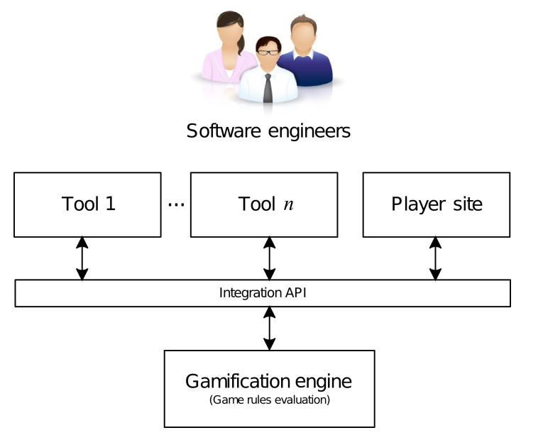
METHODS AND RESULTS
This research paper has firstly presented the software architecture and its main components: the gamification engine and the gamification model.
The gamification engine is the central element of the architecture, since it receives all the behaviours carries out by the software engineer, and evaluates them.
The engine provides an integration REST API that allows any other tools to communicate with it.
FIGURE:
High level view of the software architecture for gamification.

Slide 10
METHODS AND RESULTS
The software architecture and the gamification engine are based on a model composed of three main elements: behaviours, achievements and game rules.
The gamification engine will receive behaviours carried out by the users in their respective tools, and will evaluate these according to the game rules redefined by a designer to assign the corresponding achievements to those behaviours if the game rules consider them successful.

Slide 11
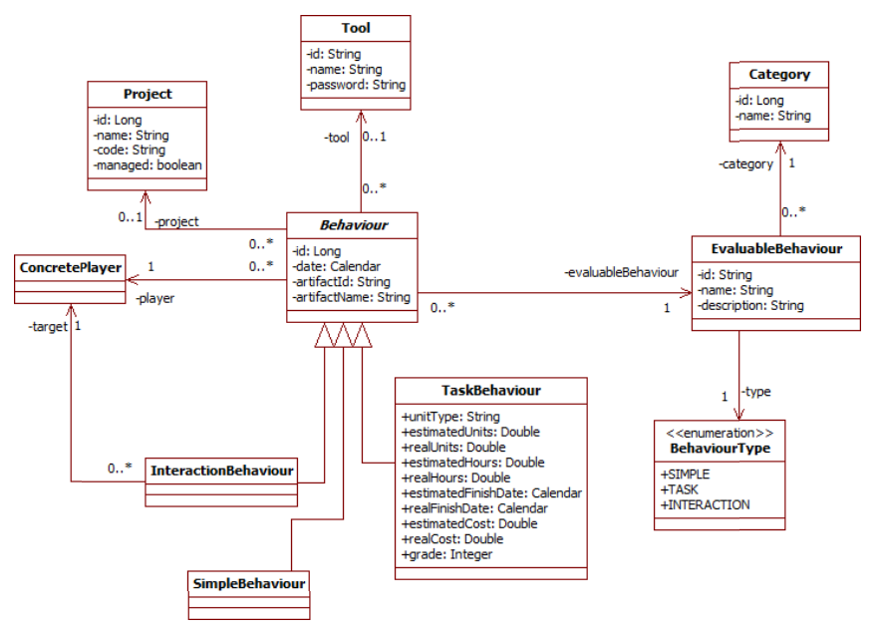
METHODS AND RESULTS
FIGURE:
Behaviour Model

Slide 12
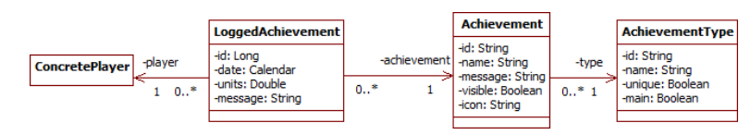
METHODS AND RESULTS
FIGURE:
Achievement Model

Slide 13
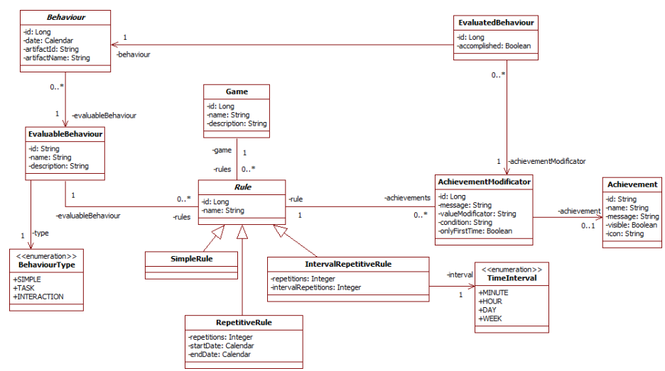
METHODS AND RESULTS
FIGURE:
Rules of the gamified environment

Slide 14
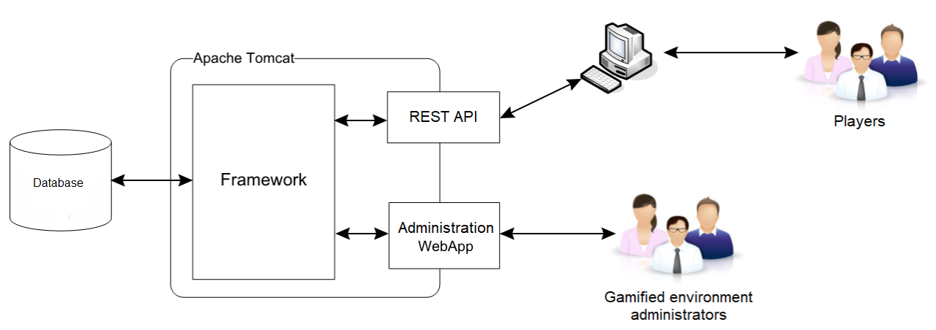
METHODS AND RESULTS
The gamification engine has been designed following a three-layer architecture.
The first layer is the data persistence implemented as a RDBMS.
The second layer is the engine model containing the data access layer and the business logic.
The third layer consists of Administration WebApp.
FIGURE:
Engine Architecture and Design

Slide 15
DISCUSSION AND CONCLUSION
The gamification engine presented in this paper provides a valuable tool for incorporating gamification in SE workplaces. The software architecture for gamification composed of many tools that support different software process area.
The effort of gamifying a work environment should not be neglected nor forgotten due to its importance for real organizations.
This paper presented a software architecture, a gamification model, and a gamification engine for the gamification of software engineering environments. The main feature of the proposal was to centralize the logging of the behaviours of the people taking part in that environment.

Slide 16
RELATED WORKS: LIST OF PRIMARY STUDIES
G. Zicherman and C. Cunningham, Gamification by Design. Sebastobol, CA, USA: O’Reilly Media Inc., 2011.
S. Deterding, D. Dixon, R. Khaled, and L. Nacke, From game design elements to gamefulness: Defining gamification, in Proceedings of the 15th International Academic MindTrek Conference: Envisioning Future Media Environments, New York, NY, USA, pp. 9–15, 2011.
M. Hugos, Enterprise Games: Using Game Mechanics to Build a Better Business. Sebastobol, CA, USA: O’Reilly Media Inc., 2012.
K. Werbach and D. Hunter, For the Win: How Game Thinking Can Revolutionize Your business. Philadephia, PA, USA: Wharton School Press, 2012.
T. Reiners and L. C. Wood, Gamification in Education and Business. Berlin, Germany: Springer International Publishing, 2015.

Slide 17
THANK YOU

